Slide 1
Elastic search 기본 API

Slide 2
Elastic search 기본 API 참고 URL
참고 URL :https://wiki.daumkakao.com/pages/viewpage.action?pageId=636782368

Slide 3
REST API
Elastic search | CRUD
GET | Read
PUT | Create
POST | Create , Update
DELETE | Delete

Slide 4
Verify index
elasticsearch ip / index name
Curl –XGET localhost:9200/classes

Slide 5
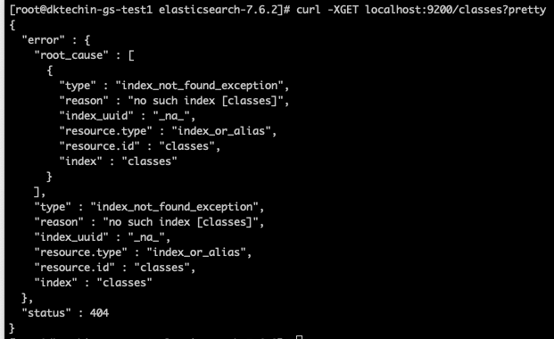
Verify index
Curl –XGET localhost:9200/classes?pretty

Slide 6
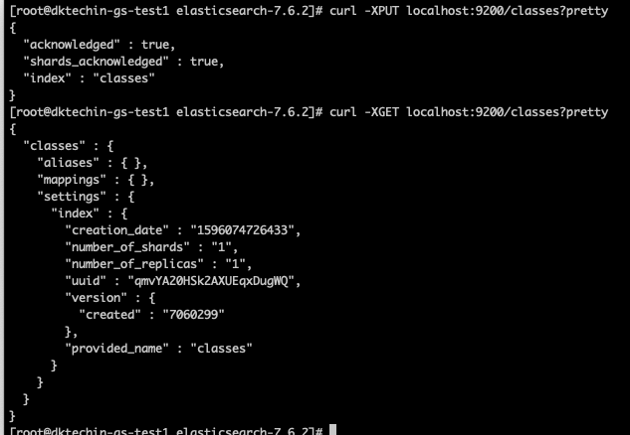
Create index
curl –XPUT localhost:9200/classes?pretty
Curl –XGET localhost:9200/classes?pretty

Slide 7



DELETE index
Curl –XDELETE localhost:9200/classes?pretty

Slide 8
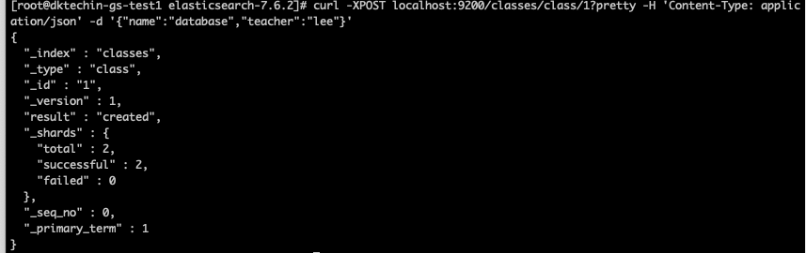
Create document(1)
Curl –XPOST localhost:9200/classes/class/1?pretty -H 'Content-Type: application/json’ –d ‘{“name” : “database” , “teacher” : “lee”}’

Slide 9

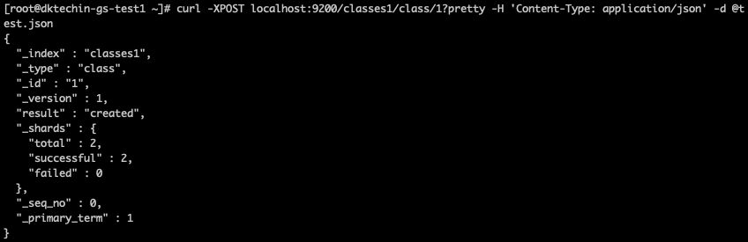
Create document(2)
curl -XPOST localhost:9200/classes1/class/1?pretty -H 'Content-Type: application/json' -d @test.json

Slide 10
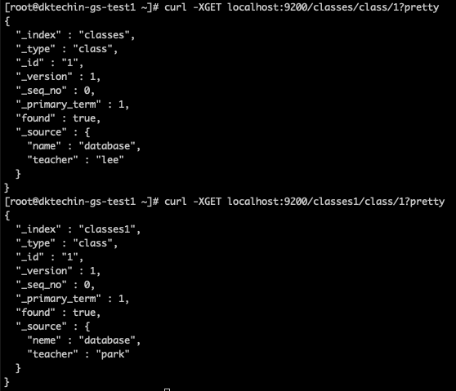
Verify document
Curl –XGET localhost:9200/classes/class/1?pretty

Slide 11
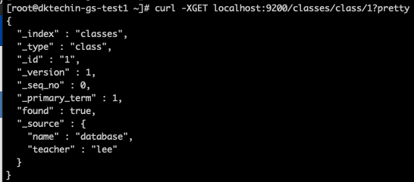
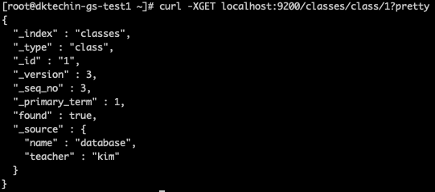
Document update
Curl –XPOST localhost:9200/classes/class/1/_update H'Content-Type:application/json' -d '{"doc":{"teacher":"kim"}}'

